Slide 1
Training a speech recognizer using data from speech Synthesis
Group 6
Ravi Kappagantu
Ravi Prakash
Ashutosh Singh
Shashank Agrawal
Senthil Kumar
Dr. Prasanta Kumar Ghosh (prasantg@iisc.ac.in)

Slide 2



Pipeline, Data Sources & Pre-trained model
2
ASR Model
1
Pre-trained TTS
ASR Training
Input Text
3
Test Set
Process Flow Diagram
1
LibriSpeech ASR Corpus (link)
2
NeMo TTS – Multi-speaker Text2Speech pre-trained model by Nvidia (link)
3
LibriSpeech ASR Corpus – Hold Out Data (link)

Slide 3
Data Pre-processing
Normalize Text:
Use Nvidia’s nemo_text_processing.text_normalization.normalize to convert symbols ad digit character to alphabetic words.
text = "Mr. Johnson is turning 35 years old on 04-15-2023."
normalized_text = text_normalizer.normalize(text)
Text becomes -> mister Johnson is turning thirty five years old on fifteenth April two thousand and twenty three.
Convert to Audio:
Fetch text sentence
Convert to a spectrogram using Pre-trained NVIDIA Nemo FastPitchModel . This model supports 20 pre-trained speaker IDs, including male and female voices.
Randomly assign speaker between 1-20 for conversion
Speakers 19, 20 go to validation directory directly (to mimic unseen speakers)
Once every 6 samples otherwise go to validation directory (to mimic unseen text)
All other go to training directory (this crates roughly 80:20 split between training and text data)
Convert to audio WAV file
Code PCM S16 LE
Channels: 1 – Mono
Sample Rate: 16000 Hz
Bits per sample:16

Slide 4
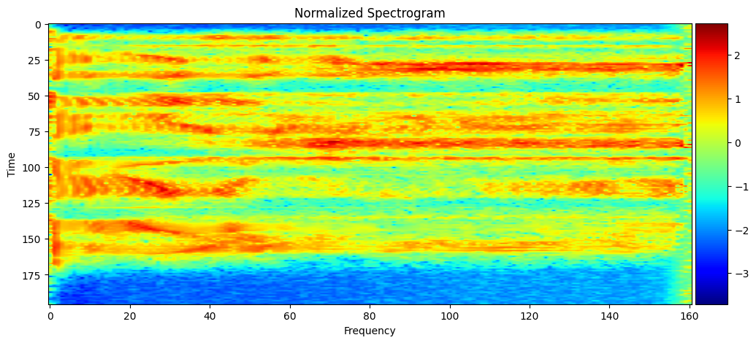
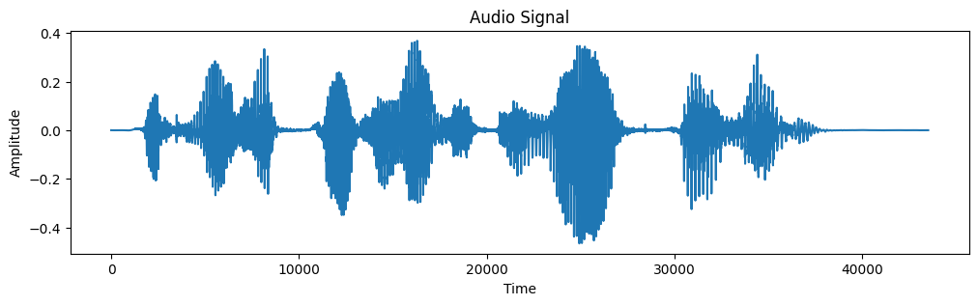
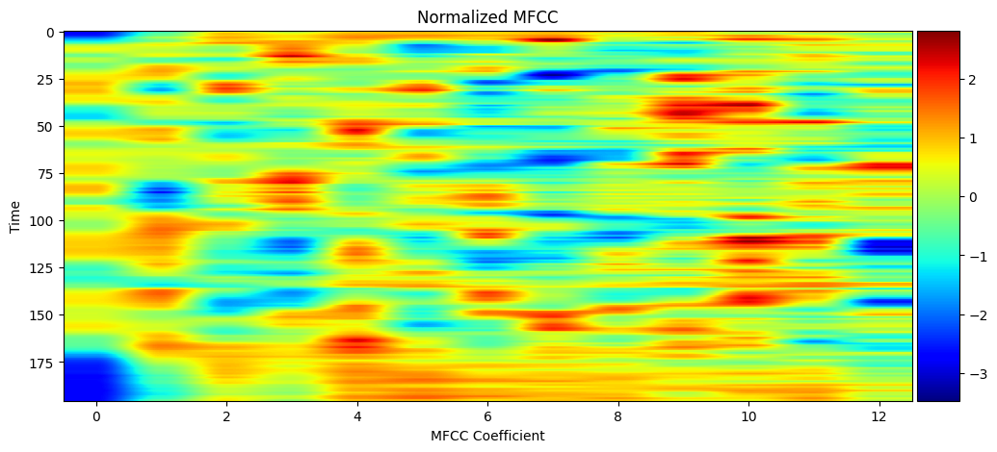
Data Pre-processing - ASR
Create Text Corpuses:
Creates a training corpus and validation corpus from last section
Each line in corpus contains ID for a sentence, WAV file path, duration of the Audio and text
Raw Audio: it was a privilege to work for him.
Spectrograms
Sample Diagram of Spectrogram 200 ms with 161 features
MFCCs
Sample Diagram of Spectrogram 200 ms with 13 features

Slide 5
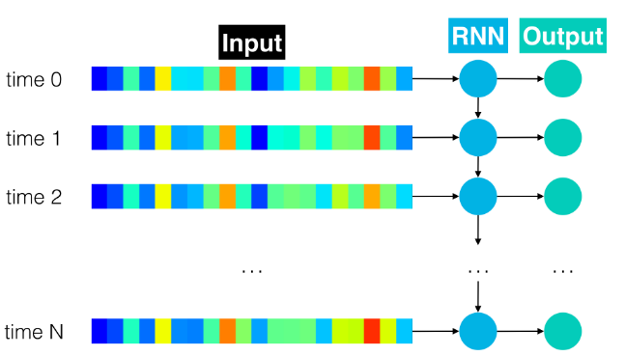
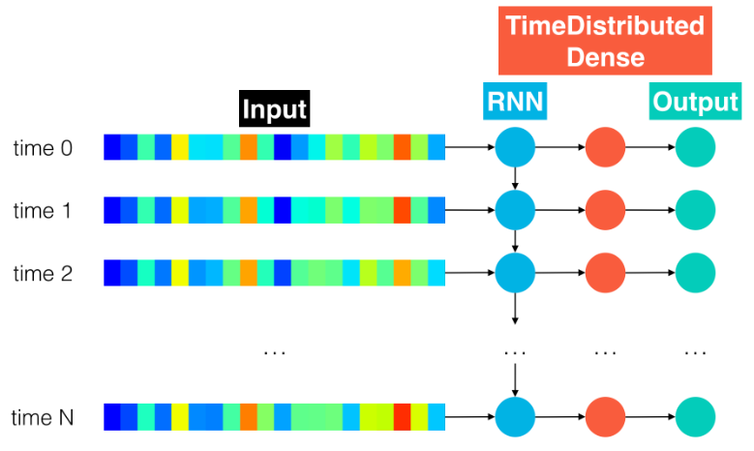
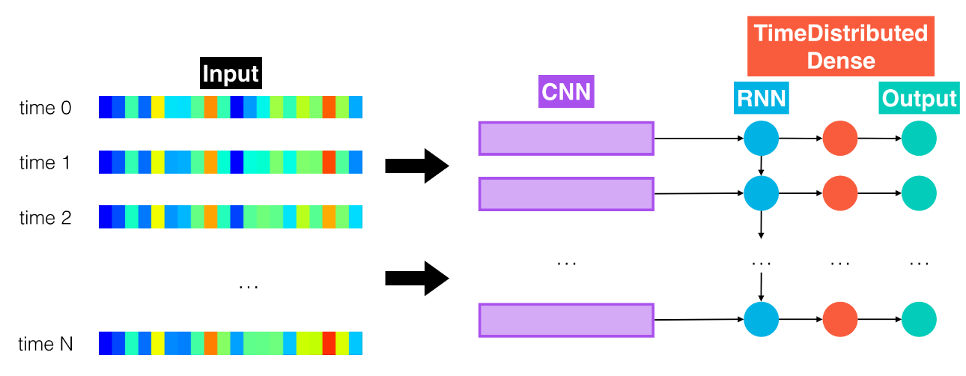
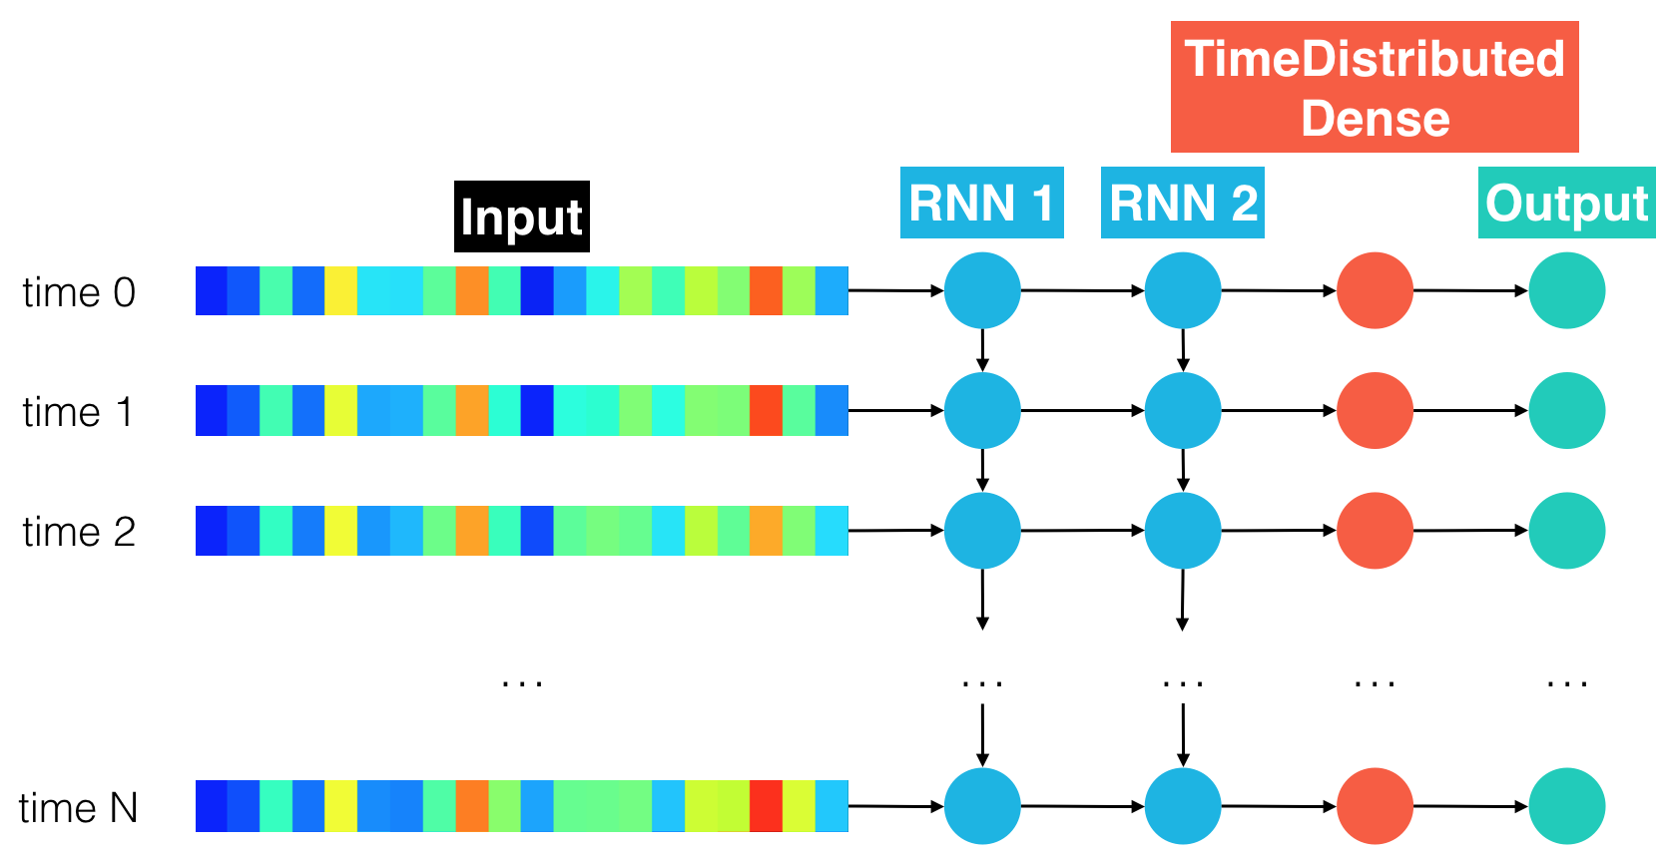
ASR Training
Model 0: RNN
Model 1: RNN + TimeDistributed Dense
Model 2: CNN + RNN + TimeDistributed Dense
Model 3: Deeper RNN + TimeDistributed Dense
Model 4: Bidirectional RNN + TimeDistributed Dense
Model Final: CNN + Deeper RNN + TimeDistributed Dense

Slide 6
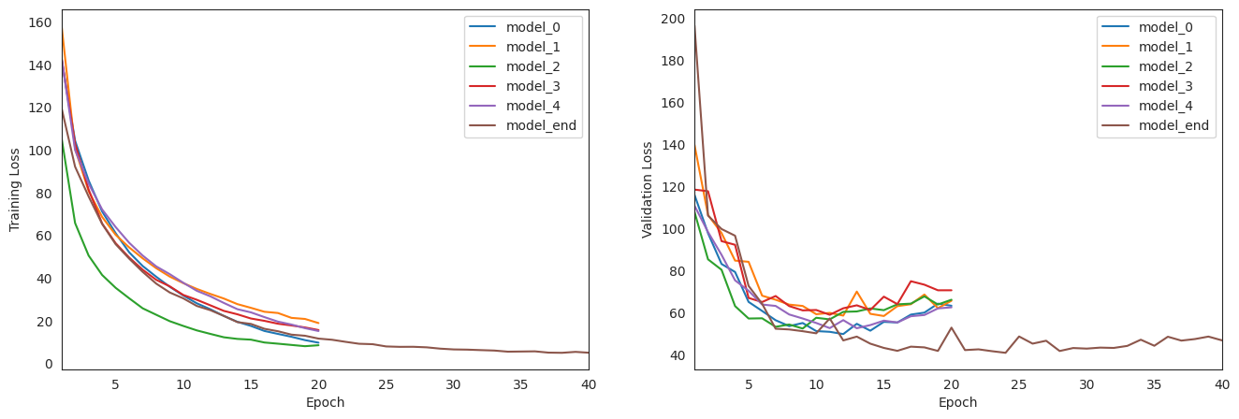
Training and Validation Loss PLOTs
Tra
Only model seemed to converge on validation loss is “model end”. So we continued to run it for 40 epochs. Though no significant improvement on validation loss, it did not significantly deteriorate as well.

Slide 7
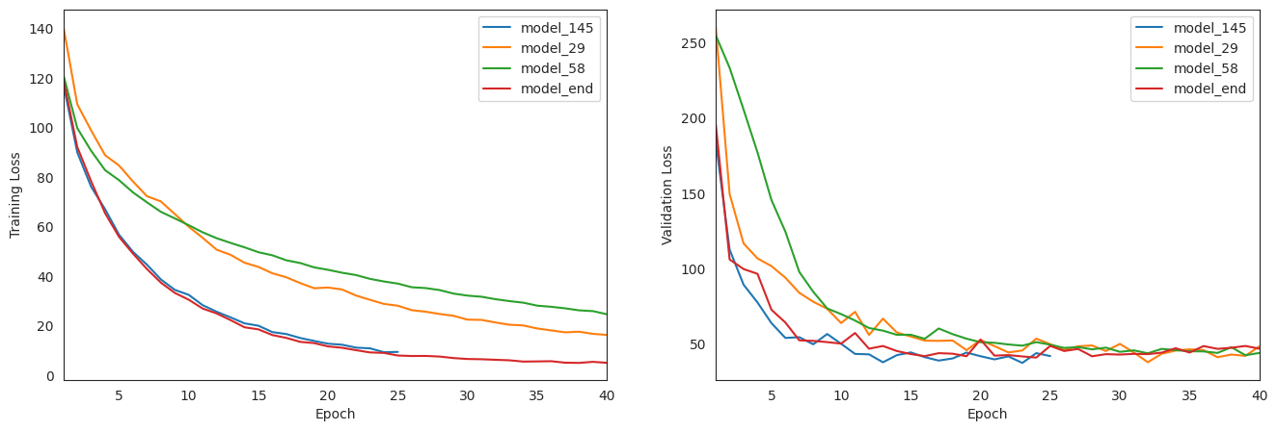
Fine Tuning Converging Model
Tra
Fine tuned final model to have the right number of CNN filters, best performance is observed when number of filters in CNN 1D later is equal to 29, number of characters in character map. Tried with multiples of 29, but right around 29 filters seemed good.

Slide 8
Model Performance & Conclusions
Model | Word Error Rate
0 | 88%
1 | 68%
2 | 32%
3 | 43%
4 | 44%
End | 24%

Slide 9
Appendix

